Slide 1

GENERATING ATM MACHINE
AN APPLICATION AND EXPLORATION OF PYTHON PROGRAMMING
Presented by Uday Kumar Bathula
HU21CSEN0100964

Slide 2

Contents
Introduction TO PYTHON
APPLICATIONS OF PYTHON
GENERATING ATM MACHINE
CODE
output
CONCLUSION

Slide 3

Introduction
Python is a high-level, general-purpose programming language that emphasizes readability and simplicity.
It was created by Guido van Rossum
It was First released in 1991.
Python has become one of the most popular programming languages.
It is Very clean , easy-to-understand syntax
It has vast of libraries and frameworks.

Slide 4

APPLICATIONS OF PYTHON
Web Development
Data Science and Analytics
Machine Learning
Artificial Intelligence
Game Development
Scripting
Operating Systems

Slide 5
ROLE OF PYTHON IN GENERATING ATM MACHINE
Python can play a significant role in the generation and implementation of ATM (Automated Teller Machine) systems. Here are several aspects of the role of Python in ATM machine generation
Rapid Prototyping and Development: it’s simplicity and readability is crucial when creating software for ATMs, where quick iterations and updates may be necessary.
Error Handling and Logging provides robust error handling mechanisms, which are crucial in the development of reliable and secure ATM systems.
Security Implementation: Python provides tools and libraries for implementing security measures.

Slide 6
ROLE OF PYTHON IN GENERATING ATM MACHINE
Cross-Platform Compatibility: is platform-independent, meaning that code written in Python can run on various platforms without modification.
Integration with Hardware: Python has libraries and modules that facilitate communication with hardware components. For example, Python can be used to interact with card readers, cash dispensers, and other devices commonly found in ATMs.
Web Services and APIs: ATMs often require integration with banking systems and third-party services. Python is well-suited for working with web services and APIs, allowing for seamless communication between the ATM software and external systems.

Slide 7
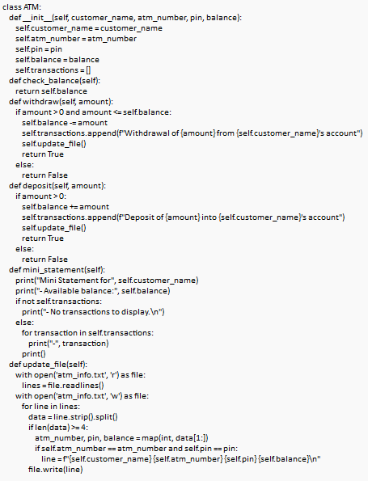
CODE

Slide 8
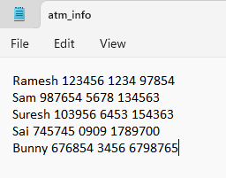
BANK DATABASE
To operate an ATM, it is imperative to possess essential customer banking information, including the customer's full name, ATM card number, PIN, and the current available balance in their account.
To streamline and organize this information, a structured text file containing distinct customer details must be created.
This file should systematically record the pertinent data for each customer, ensuring accuracy and security in the management of ATM transactions.

Slide 9
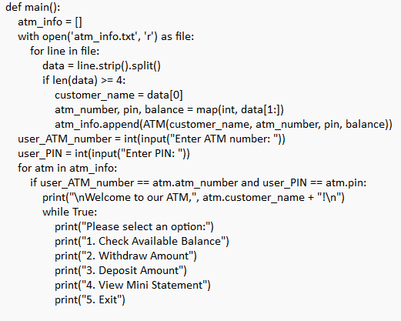
CODE

Slide 10
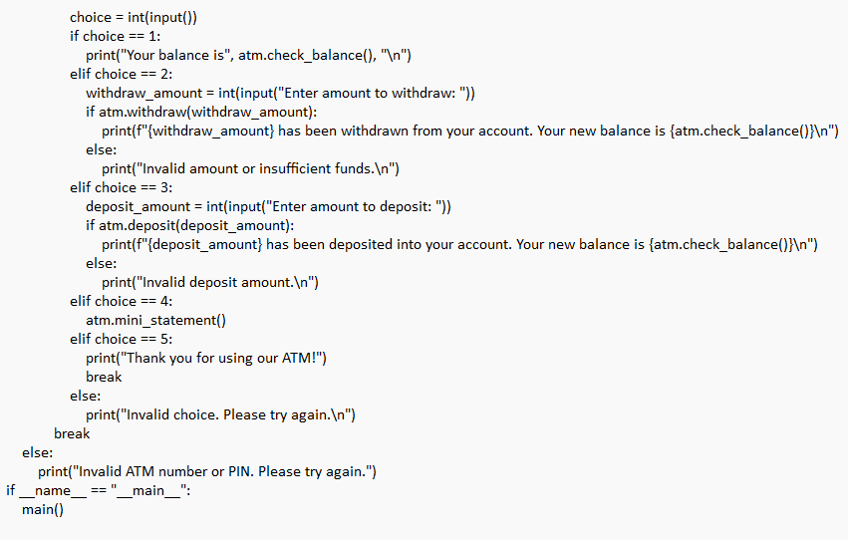
CODE

Slide 11
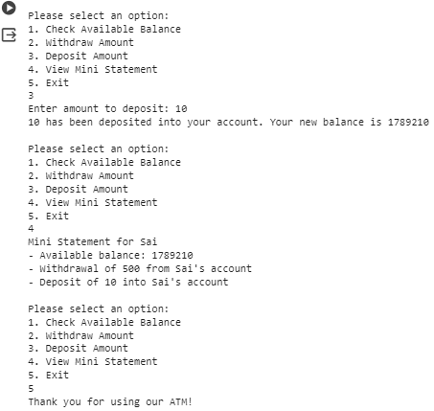
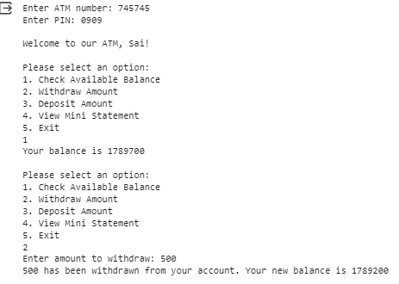
OUTPUT :

Slide 12
CONCLUSION:
In conclusion, understanding and effectively using functions in Python is essential for writing modular, reusable, and well-structured code
Object-Oriented Design:
Encapsulates functionality.
Enhances code modularity.
File Handling:
Persists account data.
Supports data retrieval.
User Interaction:
Menu-driven interface.
Prompts user input.
Code Readability:
Emphasizes clarity.
Improves maintainability.
Transaction Handling:
Validates input.
Updates account.

